Slide 1
Rishi Run
An Endless Runner Game

Slide 2
What is this game about?
Rishi Run is a simple 2D endless runner game.
It consists of three characters: Rishi, Ryan, and Eion. They’re three young billionaire philanthropists getting attacked by a Yakuza clan with bombs.

Slide 3
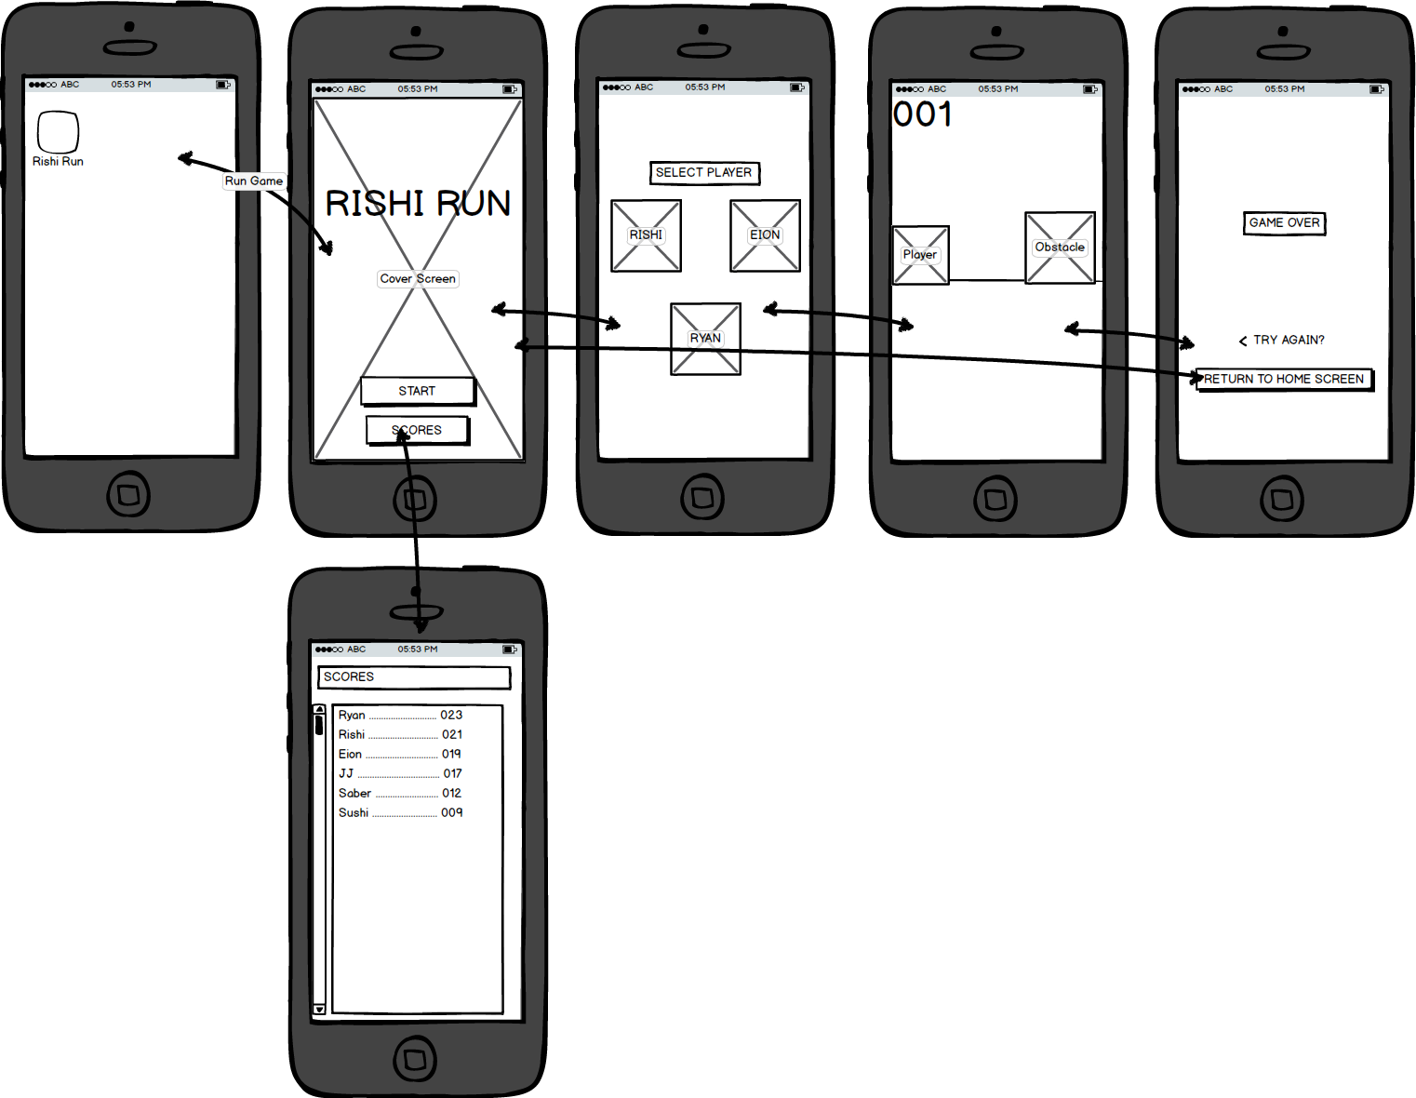
How the game is structured.

Slide 4

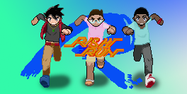
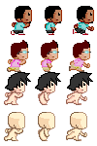
Progress...

